Slide 1
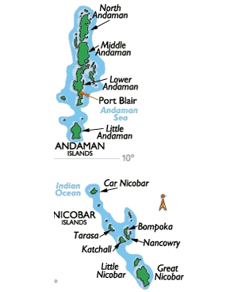
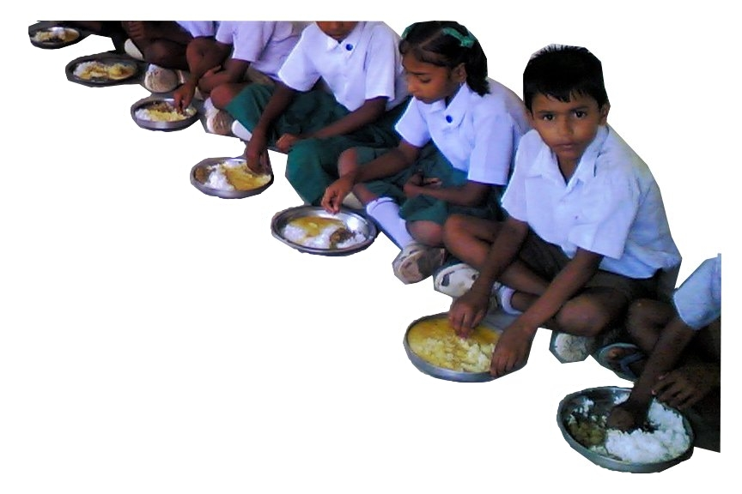
MID DAY MEAL SCHEME
ANNUAL WORK PLAN & BUDGET 2018-19
ANDAMAN AND NICOBAR ISLANDS

Slide 2
PER UNIT COOKING COST DURING 2017-18
Stage | Central Share (100%) | UT Contribution | Total
Primary | Rs. 4.13 | Rs. 6.00 | Rs. 10.13
Upper Primary | Rs. 6.18 | Rs. 6.00 | Rs. 12.18
NUMBER OF INSTITUTIONS COVERED DURING 2017-18
District | Number of Schools
 | Govt. | Govt. Aided | Local Body | Total
South Andaman | 112 | 02 | 02 | 116
N & N Andaman | 163 | 00 | 04 | 167
Nicobar | 55 | 00 | 00 | 55
Total | 330 | 02 | 06 | 338

Slide 3
Management Structure
Chief Secretary , A & N Administration.
/ Chairman SSMC
Secretary (Education), A & N Admn.
Director (Education), A & N Admn.
Deputy Director Edn (Academics) / Nodal Officer (MDM)
Zonal Officers / Principals of Education Department
Head of Schools
MDM Supplier

Slide 4
FLOW OF FOOD GRAINS (RICE)
MHRD releases allocation orders
Food Corporation of India
Transported to go-downs of CS & CA Dept located in 09 different zones of this UT
Suppliers lift from respective go-downs depending on proximity
Lifting by Civil Supplies & Consumer Affairs Dept on Quarterly basis
This UT Administration lifts the required quantum of food grains from FCI through its Nodal lifting agency, the Department of Civil Supplies and Consumer Affairs on quarterly basis.
The Department of CS & CA lifts the food grains on quarterly basis from the go-downs of FCI at Port Blair and transports the same to its go-downs / warehouses located in 09 zones.
The Mid-day meal suppliers lift the rice from the go-downs of CS & CA and transport it to the kitchen cum stores.

Slide 5
FUND FLOW
MHRD
UT ADMINISTRATION
EDUCATION DEPT.
DDOs OF EDUCATION DEPT.
SELF HELP GROUPS
Fund received from MHRD towards Central Assistance is placed at the disposal of Drawing and Disbursing Officers (DDOs) of Education Department.
The suppliers submit their monthly bills through the Heads of schools to the concerned DDOs.
The DDOs process the bills and submit the same to the Pay & Accounts Office (PAO) for payment.
The payment for Cooking Cost is made through account payee cheques and the honorarium to cook cum helpers are credited in the bank account of cook cum helpers.

Slide 6
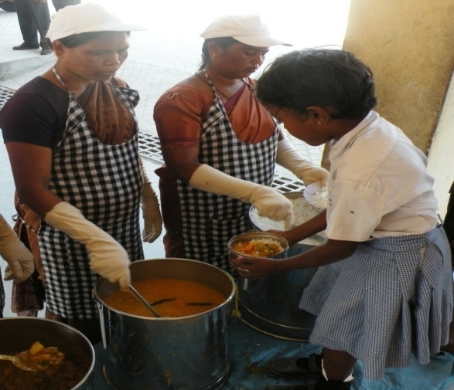
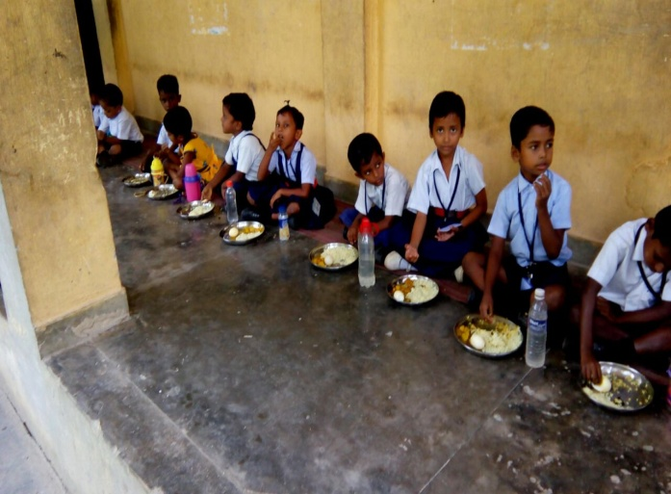
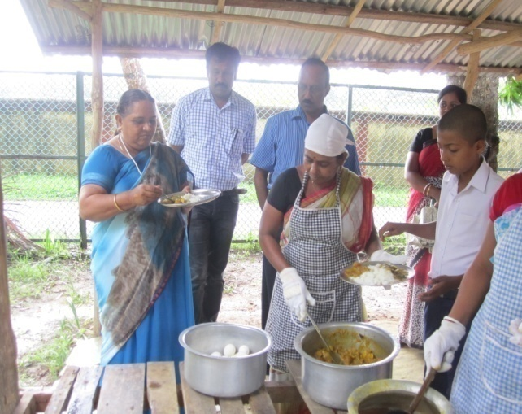
GOOD PRACTICES ADOPTED
Boiled egg twice a week and Ripened Banana once a week are being provided to the students of Pre-Primary Stage to Upper-Primary Stage as Supplementary Nutrition.
Washing Hands before Consuming Meals is mandatory.
Wearing Headgears, Aprons and Hand Gloves compulsory for staff cooking and serving MDM.
Tasting of food by teachers / SMC members before serving is a regular practice.
Food is served to all without any discrimination of Caste and Creed.
UT is providing Rs.6/day/child for Primary and Upper Primary level.
Every School has Standard Operative Procedures to be followed during emergency.

Slide 7
ACHIEVEMENT DURING F.Y. 2017-18
As on 31st March 2018

Slide 8
Average number of children availed MDM as on 31/03/2018
 | Achievement
Stage | % coverage against enrolment | % coverage against PAB approval
Primary | 76.69% | 95.93%
Upper Primary | 76.96% | 94.72%

Slide 9
Allocation & Utilization of Food grains as on 31/03/2018
691.17 MTs
658.72 MTs
Stage | 2017-18 as on 31/03/2018
 | % of utilization against allocation.
Primary | 95.93%
Upper Primary | 94.71%

Slide 10
Allocation & Utilization of funds for Food grains upto 31/03/2018

Slide 11
Allocation & Utilization of funds for Cooking Cost as on 31/03/2018
PRY
(201.28 )
+
Up. PRY
(142.28)
PRY
(138.53 )
+
Up. PRY
(146.56)
PRY
(201.28)
+
Up. PRY
(142.28)
% of Expenditure against annual allocation
Central Assistance | 94.81%
UT Fund | 100%

Slide 12
Allocation & Utilization of funds for Honorarium to Cook-cum-Helpers
(In Lakhs)
Stage | Achievement against annual allocation
Primary | 100%
Upper Primary | 100%

Slide 13
Allocation & Utilization of funds for MME (Management , Monitoring & Evaluation) as on 31/03/2018
% of Expenditure against fund released
As on 31/03/2018 | 99.4%

Slide 14
Allocation & Utilization of funds released towards Transportation Assistance
as on 31/03/2018
% of Expenditure against fund released
As on 31/03/2018 | 99.59%

Slide 15
Financial Achievement as on 31st March, 2018
Central Assistance :-
(in Lakhs)
Sl. No. | Component | Approved outlay | Fund received | Fund utilized till 31/03/2018 | % of Expenditure
1 | Cooking Cost | 285.08 | 285.09 | 270.32 | 94.8%
2 | Cost of Foodgrain | 20.73 | 19.67 | 19.67 | 100%
3 | Transportation Assistance | 5.18 | 4.93 | 4.91 | 99.6%
4 | Honorarium to CCH | 72.1 | 72.1 | 72.10 | 100%
5 | MME | 6.9 | 6.86 | 6.82 | 99.4%
Total |  | 389.99 | 388.65 | 373.82 | 96.2%
UT Fund:-
(in Lakhs)
UT Fund | Fund Allocated for MDM including UTs Scheme of supplementary nutrition | Expenditure till 31/03/2018 | %
 | 745.00 | 742.45 | 99.65%

Slide 16
Status of construction of Kitchen cum Stores
No. of Kitchen Cum Stores sanctioned by MHRD | Constructed | In progress
251 Units | 156 Units | 03 Units
251 Kitchen cum Stores sanctioned in the year 2013-14 with a project cost of 1720 Lakhs to be shared by MHRD and UT on 75:25 sharing basis.
Out of 1290 Lakhs being the Central Share MHRD released 802.30 Lakhs.
Out of 802.30 Lakhs , this UT booked an amount of Rs. 689.21 Lakhs and Rs. 113.09 Lakhs was surrendered.
During 2016-17,PAB approved an outlay of Rs. 1532 Lakhs for construction of 155 Kitchen-cum-store but no funds were allocated in the FY 2016-17.
No sanctions for construction of Kitchen–cum-store during 2017-18 were made by PAB.
UT proposes to release the approved outlay of Rs. 1532 Lakhs during this FY to complete the construction of remaining Kitchen-cum-store.

Slide 17

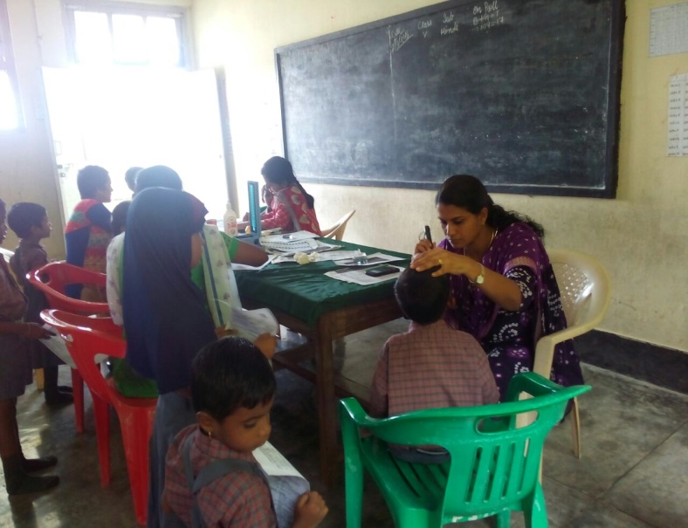
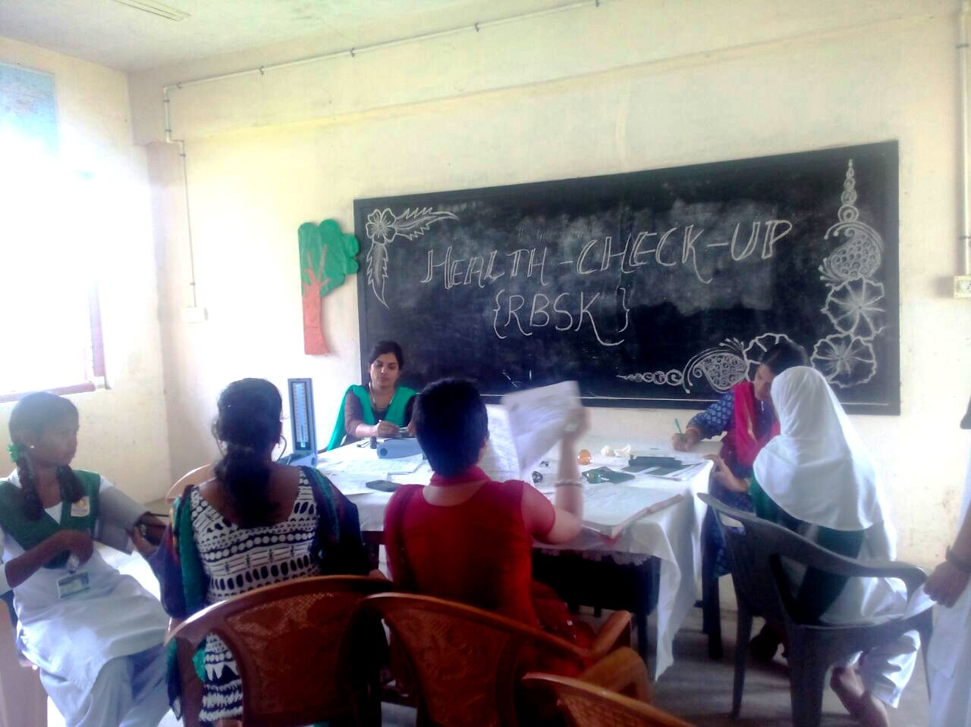
Coverage under School Health Programme
Health Check Up
No. of students covered -22830
Distribution of IFA Tablets
No. of students covered -25113
Distribution of Spectacles
No. of students covered - 498
No. of schools covered
225

Slide 18
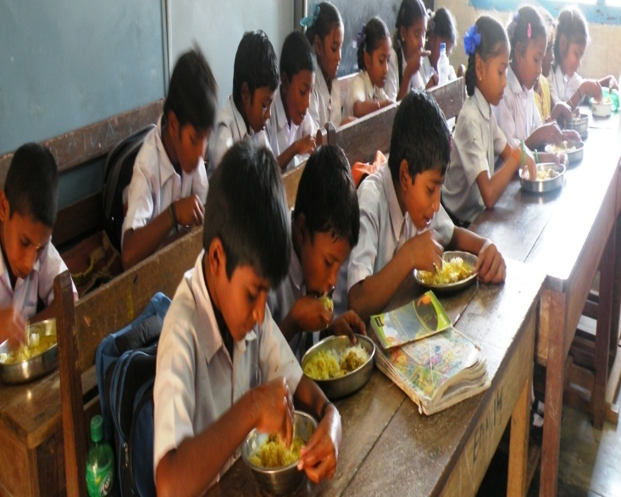
Action taken note on the commitments made by the UT in the last
PAB Meeting
Coverage of Children
A necessary direction has been issued to all Head of Institutions / Zonal Officers to ensure that every child is covered under Mid Day Meal Scheme and absenteeism is curbed. Corrective measures are being taken by the Head of Institutions / Zonal Officer.
DLC meetings during the year 2017-18
01 DLC meetings have been conducted in 03 Districts of A&N UT during the FY 2017-18.

Slide 19
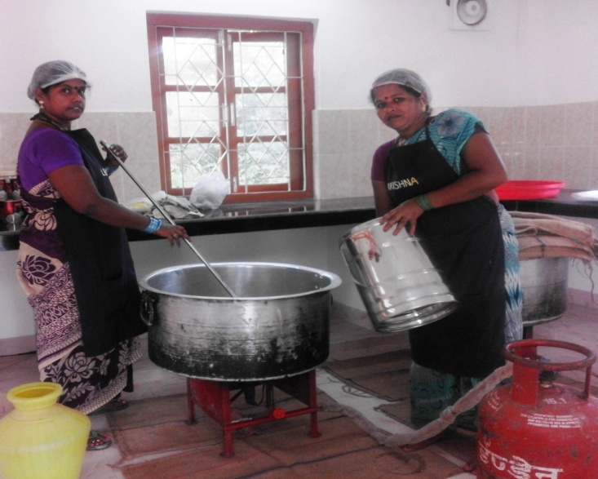
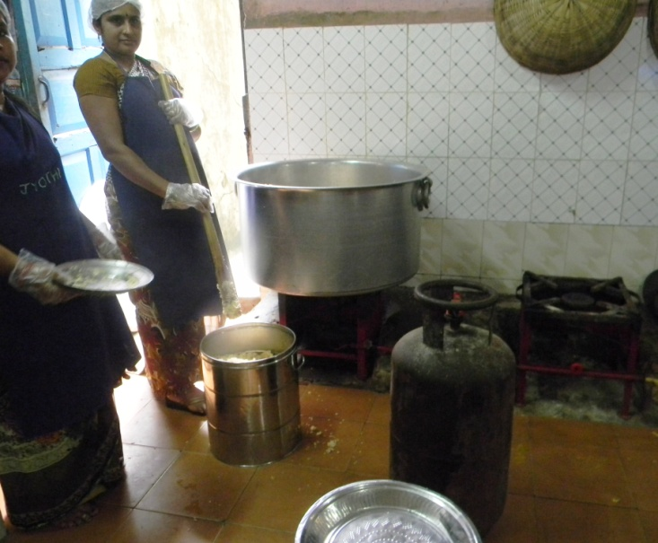
3. Provision of LPG Connections to the Schools
Out of 116 schools, 99 schools of South Andaman District have been covered under LPG based cooking. Sincere efforts will be taken to cover remaining 17 schools of South Andaman Districts till the end of 2nd Quarter of FY 2018-19 and efforts are being taken to cover rest of the schools of the remaining two Districts of this UT under LPG based cooking in a phased manner..

Slide 20
PROPOSAL FOR F.Y 2018-19
Anticipated number of working days : | 220 days (Primary & Upper Primary)
Targeted no. of children as per achievement of F.Y 2017-18
Primary | 14628
Upper Primary | 10210
Total | 24838
Requirement of Food Grains for 2018-19
Stage |  | Requirement in MTs
Primary @ 100 gms / day /child |  | 321.82
Upper Primary @ 150 gms /day / child |  | 336.93
 | Total | 658.75

Slide 21
Requirement of Central Assistance for recurring components (in Lakhs)
Sl. No. | Component | Requirement
1 | Cooking Cost | 271.73
2 | Cost of Foodgrains | 19.76
3 | Transportation Assistance | 4.94
4 | Honorarium to Cook cum helpers | 72.10
5 | Management Monitoring and Evaluation | 6.63
 | Total | 375.16

Slide 22
UTs Proposal for Grant of Additional Central Assistance For Implementation of Supplementary Nutritional Scheme
Sl. No | Items | Periodicity | Quantum | Total Expenditure against targeted no. of Children | UT Share (in Lakhs ) | Central Share (in Lakhs )
1 | Boiled Eggs | Thrice a week | One egg per day / child | 214.00 Lakhs (24838X6.5X3X44) | 143.00 (for twice a week) | 71.00 (for once a week)
2 | Banana | Once a week | 150 gms | 6.56 Lakhs (24838X6X1X44) | 6.56 (for once a week) | -
3 | a).Boiled Chana b). Coarse grain Laddu with juggery (millet / mole) c). Peanet Chikkis | Once a week | a). 50 gms b). 20 gms c). 20 gms | 5.47 Lakhs (24838X5X1X44) | - | 5.47 (for once a week)
Total |  |  |  | 226.03 Lakhs | 149.56 | 76.47
MHRD may release ` 76.47 Lakhs additional Central Assistance to facilitate this UT in implementation of Supplementary Nutritional Scheme.

Slide 23
THANK YOU

